Slide 1
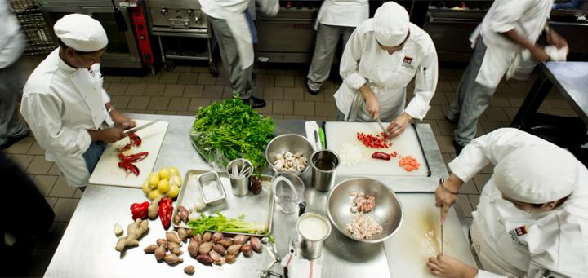
Be Prepared ! Visitors are Coming ?
“ ’AirReg Website’ Restaurant Visitor Forecasting”
Anna Pavlova, GA DSI-7

Slide 2


Data available through AirRegi website
829 Restaurants across Japan
Time Period 1.5 years
Daily Visitors Records
Available Data:
Main:
air_store_id
visit_datetime
visitors
Related:
reserve_datetime
reserve_visitors
air_genre_name
air_area_name
latitude
longitude

Slide 3
Approach
Time Series (univariate)
Regression (multivariate)
Auto_arima(p,d,q)(P,D,Q,m)
p- autoregressive term
d- degree differencing
q- moving average order
P- seasonal autoregressive term
D- seasonal degree differencing
Q- seasonal moving average order
m- “mystery component”
Evaluation: AIC (Akaike Information Criterion) and BIC (Bayesian Information Criterion) values are estimators to compare models.
Engineer Features:
Deconstructed Date, Weekday,
Area name, Geo Location, Food Genre,
Statistical Summaries
Fit, Transform, Evaluate:
Prophet (Facebook freeware)
Fully automated .
Built-in cross validation function.
Robust to outliers, missing data, sharp change.
Still has tunable parameters.

Slide 4
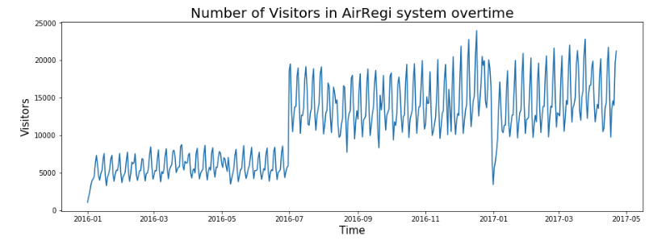
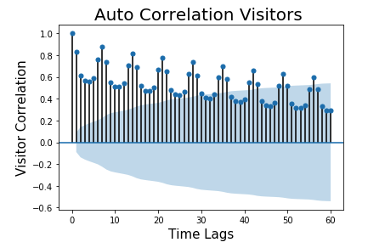
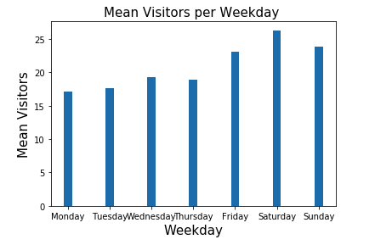
Exploring Data Time Correlation
Restaurants were added to the system June 2016
Strong weekly trends for all restaurants
Baseline prediction score was established
Baseline 1:
Mean visitors per weekday across for each restaurant
How about individual restaurant trends ?
 | RMSE | R^2
Baseline 1 | 16.43 | 0.04

Slide 5
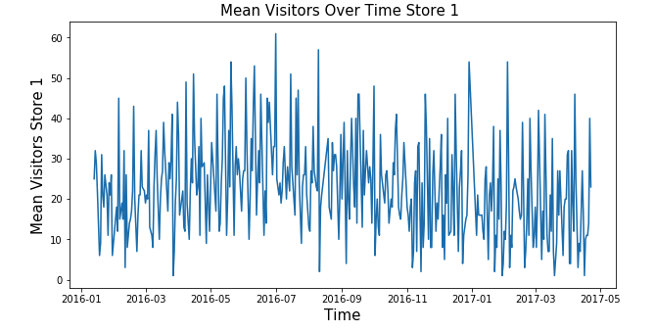
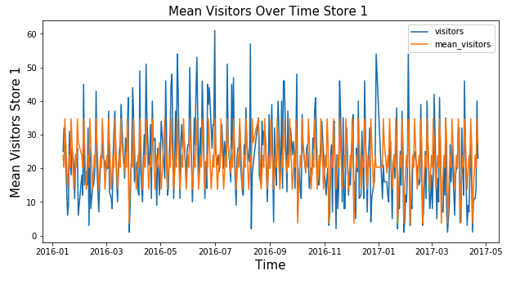
When Weekly Means are Not Enough
Mean number of visitors per weekday per each restaurant individually does not accurately predict future visitors
 | RMSE | R^2
Baseline 1 | 16.43 | 0.04
Baseline 2 | 11.09 | 0.56

Slide 6
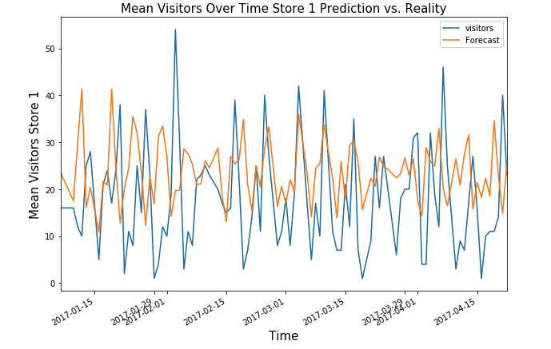
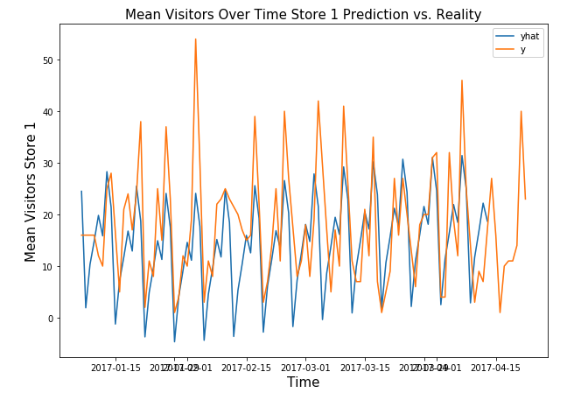
Does past visitors predict the future ?
ARIMA
Time series analysis with
ARIMA and PROPHET
Does not accurately predict future visitors
PARTIALLY Yes/No
Prophet
 | RMSE | R^2
Baseline 1 | 16.43 | 0.04
Baseline 2 | 11.09 | 0.56
autoARIMA | 14.14 | -0.59
Prophet | 14.97 | -0.79

Slide 7
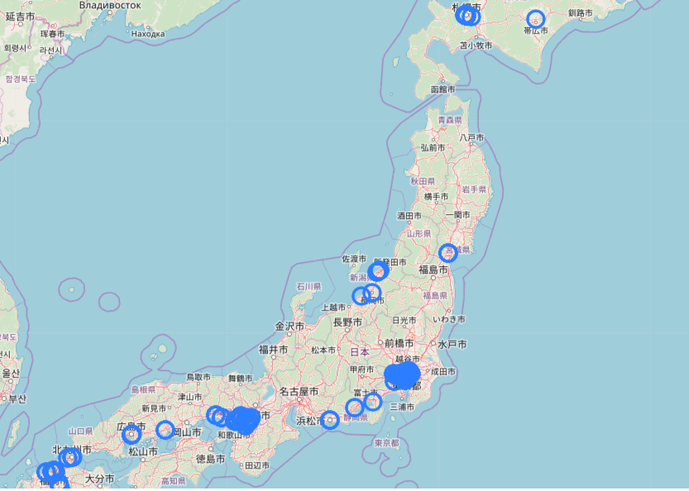
Exploring number of visitors in relation to restaurant specific factors.
Geo-Spatial coordinates
e.g.
Location relative to competition
Location relative to busy areas
Etc.

Slide 8
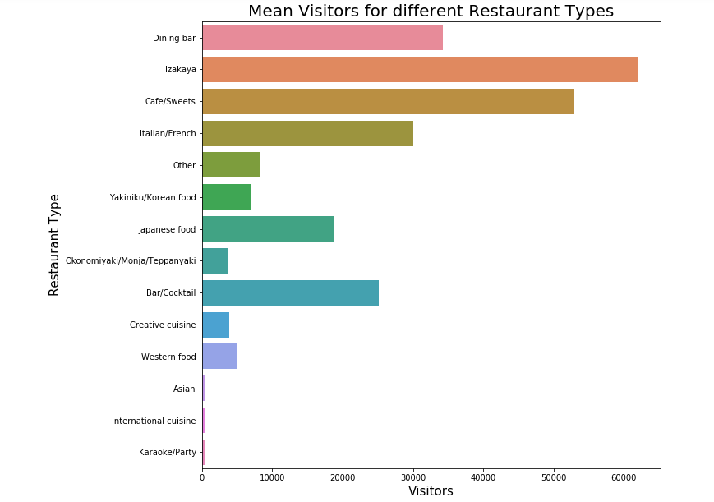
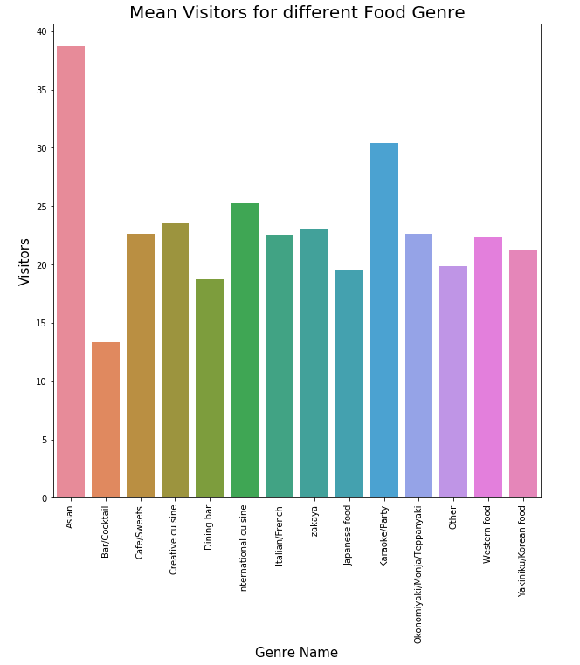
Visitor NUMBERS in relation to restaurant specific factors.

Slide 9
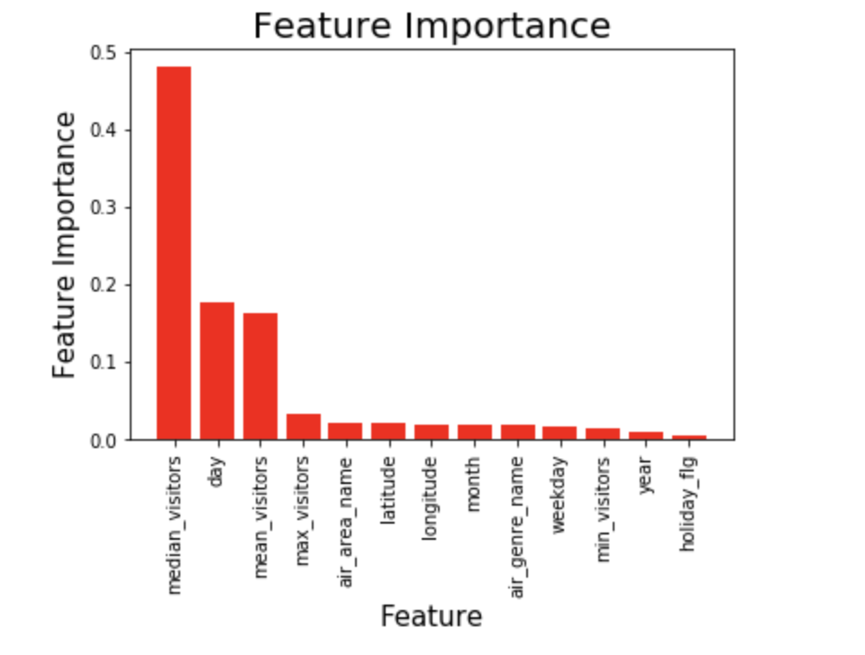
Feature Engineering for Regression Analysis
How to turn our limited data into additional fieatures:
Date: 05-17-2019 --> 5, 136, 2019, Friday
Latitude, Longitude: 35.65, 139.75
Visitors: 25 → min: 7 , mean: 23.8, median: 25, max: 57
Genre_name: Dining bar
Area_name: Tokyo-to-Minato-ku-Shibakoen
Holiday: Yes

Slide 10
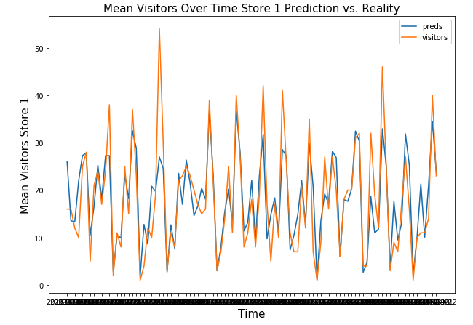
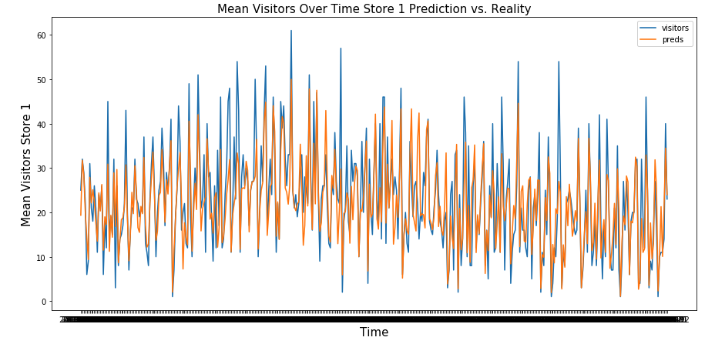
Do circumstances and the past visitors predict the future ?
Regression analysis with multiple engineered features
More accurately predict future visitors
Features added:
latitude and longitude
cuisine genre, type of restaurant
week-day specific visitors minimum, maximum, mean median for each specific restaurant
year, month, weekday and day of the year
YES !
 | RMSE | R^2
Baseline 1 | 16.43 | 0.04
Baseline 2 | 11.09 | 0.56
autoARIMA | 14.14 | -0.59
Prophet | 14.97 | -0.79
RandomForest | 0.356 | 0.8

Slide 11
Conclusions
Accurate visitor forecasting was achieved for 829 different restaurants in this study with application of multivariate regression modeling.
Prediction of daily visitors at different restaurants in Japan depends on many parameters, including date, location, cuisine genre, restaurant type.
Data is easily accessible through combination of data mining and datasets collected through AirRegi/Restaurant board website. Features could be added to website
Results may be used to significantly relieve the pressure of planning daily operations in tough restaurant business.

Slide 12
Future Directions
Techniques to explore:
Multivariate Time Series analysis.
Neural Networks
Bayesian analysis
Survival Analysis
Now: Temporal Convolutional analysis
More features could be explored:
Geo-spatial data to determine spatial proximity of each restaurant from busiest areas and competition.
Weather in different areas of the country.
Demand for certain types of areas
How busy are different areas
Etc.
Proposed additions to the app:
Weather tracking,
New/retired restaurants in the area
Restaurant review tracking
Restaurant inventory tracking to advise on ingredient purchasing and staff requirements.

